Slide 1
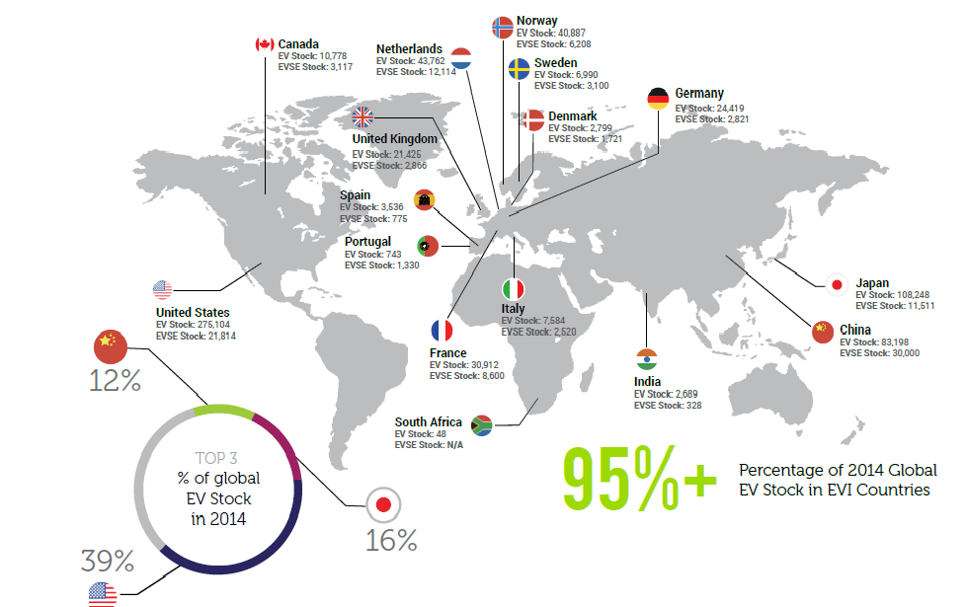

Electrical Vehicle Global Market

Slide 2
Cooment for page 1
The Electric Vehicles Initiative (EVI) is a multi-government policy forum dedicated to accelerating the introduction and adoption of electric vehicles worldwide.
EVI currently includes 16 members
EVI MEMBER COUNTRIES HELD OVER 95% OF WORLD ELECTRIC VEHICLE (EV) STOCK IN 2014
US , China and japan are top 3 global EV stock holders.

Slide 3
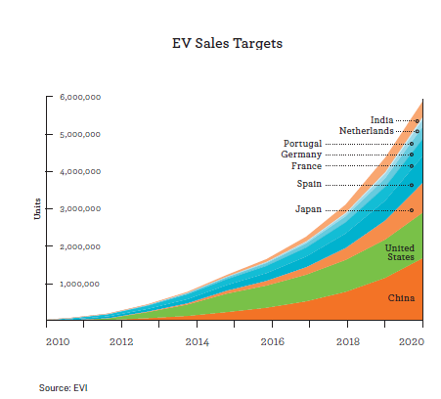

Slide 4
Comment for page 3
This figure shows cumulative sales target for EVI members which has official target until 2020.
The target is 5.9 million .

Slide 5
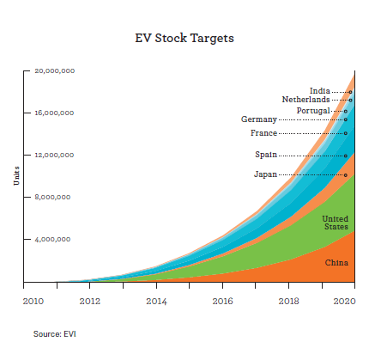

Slide 6
Comment for page 5
The stock target is 20 million .

Slide 7
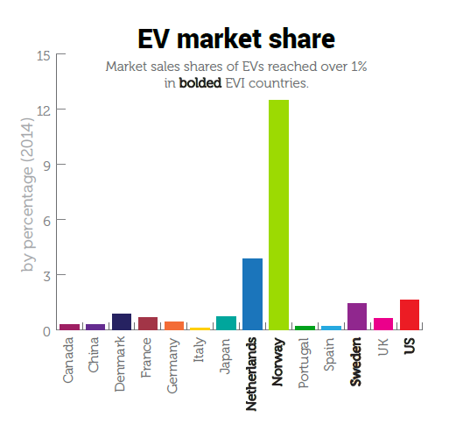

Slide 8
Comment for page 7
As can be seen from this bar chart , excluding Norway and Netherland ,in other countries , electrical vehicle sales only reached up to 3% of total vehicle sales .

Slide 9
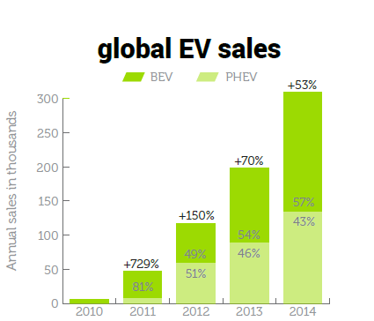


Slide 10
Comment for page 9
This bar chart shows the rapid growth of global EV sales . In 2014 ,the global EV sales was 53% higher than 2013.
Also we can see user prefer battery electric vehicle to plug in hybrid electric vehicle.

Slide 11
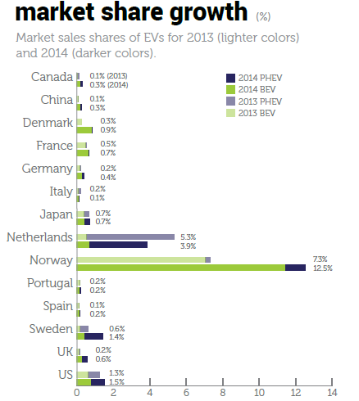

Slide 12
Comment for page 11
This chart shows the market growth for EVI countries separately . Excluding Netherland ,in other EVI countries . EV market share growth in 2014 were higher than 2013 .

Slide 13
